Slide 1

EXPLORING LANGUAGE & NLP CHALLENGES FROM
"ARRIVAL" (2016)
Presented by: Group 04 Lufei Yu, Oman Malek, Tien Manh Nguyen, Phillip Torres Course: ITAI 2376

Slide 2
INTRODUCTION
Arrival (2016), directed by Denis Villeneuve, explores contact with extraterrestrials through communication and language.
The film presents linguistic challenges that are similar to Real-World Natural Language Processing (NLP) challenges.
We cover key NLP challenges and their connection to the film’s display of communication and language.

Slide 3
SUMMARY OF "ARRIVAL" (2016)
Dr. Louise Banks, a linguist, is selected to translate the language of extraterrestrials called Heptapods.
Heptapod’s language consists of complex symbols or “Logograms”.
Dr. Louise Banks uses semantic analysis, pattern recognition, and contextual interpretation.

Slide 4
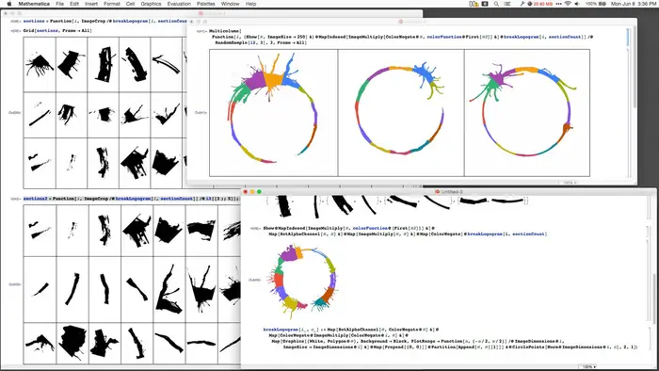
NLP CHALLENGES IN "ARRIVAL"
1. Ambiguity & Multiple Meanings
"Offer" vs. "Weapon“ is misinterpretation due to polysemy.
NLP models struggle with ambiguous and multi-meaning words that require contextual understanding.
2. Idiomatic Expressions & Cultural Differences
Human languages use idioms or metaphors, that are hard to translate.
NLP models struggle with non-literal expressions.

Slide 5
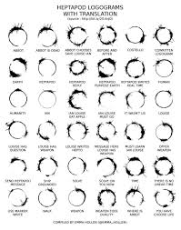
NLP CHALLENGES IN "ARRIVAL"
3. Semantics VS Syntax
Heptapod’s language express entire thoughts or expressions non-linearly.
NLP models are challenged in extracting true meaning without structure or context.
4. Data Processing & Symbolic Representation
Heptapods’ pictogram-based (picture based) language involves pattern recognition.
Similar to Optical Character Recognition (OCR) and machine translation in NLP.

Slide 6
ANALYSIS OF COMMUNICATION METHODS IN "ARRIVAL" AND NLP PARALLELS
1. Rule-Based NLP
Dr. Banks initially records symbols to human linguistic rules.
Like rule-based NLP models that follow grammatical structure.
2. Statistical NLP
Dr. Banks discovers patterns in the Heptapod-language.
NLP use Hidden Markov Models (HMMs) for statistical pattern recognition.

Slide 7
DEEP LEARNING & NLP
Dr. Louise Banks fully understands the Heptapod language when she starts to think non-linearly.
Deep Learning NLP models (transformers) process languages thoroughly, capturing context and meaning.
Real-world example: Chat GPT models learn from large amounts of data to generate human-like responses.

Slide 8
REFLECTION AND INSIGHTS
Arrival emphasizes the Whorfian hypothesis of language shapes thoughts.
A challenge for NLP, is understanding different linguistic structures.
An Ethical Concern: Misinterpretations in NLP (bias or misinformation) can have major effects.

Slide 9
CONCLUSION
Arrival provides a comparison for the complexities of NLP.
Challenges such as non-linear language, ambiguity, and idioms are real-world NLP issues.
The film emphasizes the need for advanced AI tools for translation to understand linear and nonlinear languages.

